Slide 1
Staff Scheduling Problem Lifeguard Services. How many to start each day, given they must work 5 days in a row?
Daily Staffing Needs & Costs
Objective function
Monday 18 $610
Tuesday 16 $635
Wednesday 14 $660
Thursday 12 $660
Friday 17 $650
Saturday 19 $650
Sunday 21 $635
Decision variables
Constraints

Slide 2
Optimization
Modeling decisions in a way that you can find the decisions that will either maximize or minimize an objective, subject to constraints
For the next two weeks, the types of optimization that we will consider in K507 include the following DETERMINISTIC models:
Linear Programming (In Excel language: Solver—Simplex LP)
Nonlinear Programming (Solver—GRG nonlinear)
Genetic Algorithms (Evolutionary Solver)
Integer Programming (Solver—any of the above with additional integer constraints)

Slide 3
Deterministic Models (LP, NLP, Evolutionary)
Every model has:
Objective Function (maximize or minimize)
Decision Variables
Constraints
Deterministic models have no random elements. (Monte Carlo Simulations are useful when there are random elements to your models.)

Slide 4
Optimization Models Have Three Primary Components
Objective
What is it that we are trying to optimize?
Examples: Minimize Cost, Maximize Profit
In Excel, this will be a single cell, and must be a formula (or less commonly a decision variable that affects constraints)
Decision
Variables
What variables can we change? (Excel calls these “changing variable cells”)
Examples: Units to produce, Quantity from each source
In Excel, this will be one or more cells, none of which are formulas
Constraints
What limits our choices?
Examples: Non-negativity, Market size, Material balance,
In Excel, this will be one or more cells, compared to constants or other cells

Slide 5
Introduction to Linear Programming
Linear Programming is a deterministic optimization technique, a subset of Mathematical Programming in general
The Mathematical Technique for Linear Programming is called the “Simplex Method”. It was originally developed in the 1930s and 1940s. With the advent of computing, the technique has been increasingly used across myriad applications. Excel has made its use possible and attractive in even more kinds of settings.

Slide 6
What makes a problem a Linear Program (LP)?
Decision variables (in the objective or constraints) are multiplied only by constants and never to a power (other than one) nor to each other.
Examples: if x and y are decision variables, then the following are linear:
x + 2y < 3
1.5x >= 25y
x – y + 13 = 0
On the other hand, the following are non-linear:
x^{1/2} + y ²
3x + xy
If you graph a linear program (with two variables), all equations are lines.

Slide 7
What are advantages of LPs?
Simplex Method
Optimal solution, if it exists, can be found quickly
Solution will be the global (max or min) solution—however, it may be possible to have multiple solutions (e.g., decisions) that give the same optimal objective value.

Slide 8
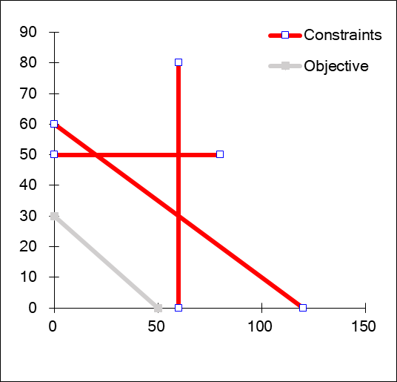
Linear Programs
example:
If you want to follow along, this is in the file: LP Classroom example.xlsx

Slide 9
Linear Programs
general format:
Linear algebra notation:
What makes this linear?
What are the…
Decision variables?
Objective? Constraints?

Slide 10
After Running an LP Model, we Learn:
(Best) Value of objective function
Optimal value of each decision variable (may not be unique)
What else would we like to know?

Slide 11
Linear Programming Sensitivity Analysis
Change in the objective function that would result from increasing the right-hand side of a constraint by 1 unit
Shadow Price
Allowable Change
to Constraint
Amount the right-hand side of a constraint can be changed without affecting the shadow price
Amount the decision variable’s coefficient in the objective function can be changed without affecting the optimal values of the decision variables
Allowable Change to
Objective Coefficient

Slide 12
Lifeguard Services at Myrtle Beach
If you want to follow along, this is in the file: Lifeguard Case class example.xlsx

Slide 13
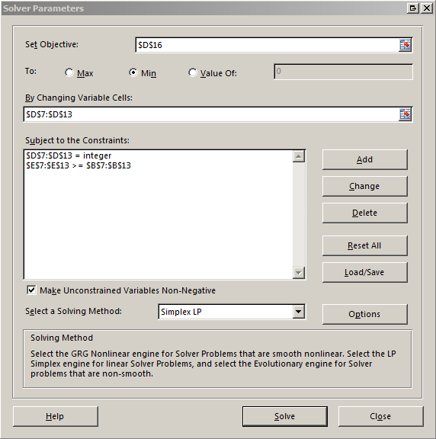
Use (Data: Solver) to find the best solution:

Slide 14
SUPPLY CHAIN: Transportation Problem Amazon
Fulfillment centers (Supply)
Customers
(Demand)
Ship Cost
4
UK
(300)
S. Korea
(600)
2
4
Japan
(350)
2
6
Germany
(600)
3
US (west coast)
(350)
If you want to follow along, this is in the file: 0503 supply chain…xls

Slide 15
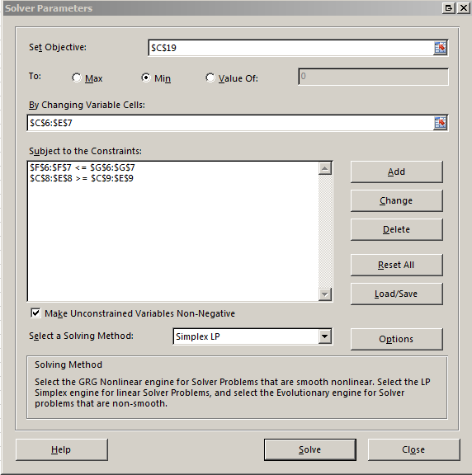
Try it out:
Open the Excel file: “0503…”
Click on the “Data” ribbon, then “Solver”
Set Objective: Total Costs (in green) cell c19
Changing cells: (in blue) cells c6:e7
Add constraints: (in red)
Don’t ship more than is available:
tot shipped<=avail cells f6:f7<=g6:g7
Be sure to meet all demand:
Ship >= demand cells c8:e8>=c9:e9

Slide 16
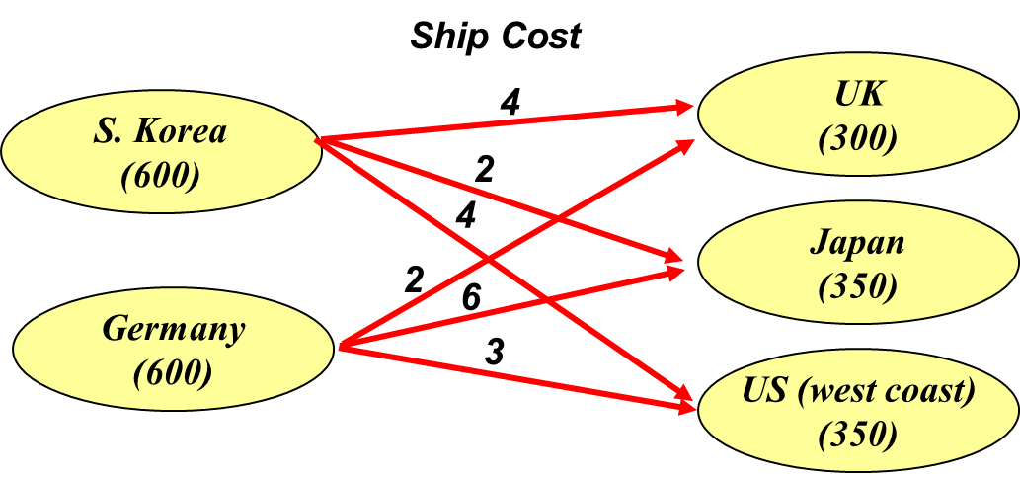
Shadow Prices
If you increase a constraint by 1 unit, by how much will the objective (total shipping costs) change?
Increase supply?
One unit in Germany?
Increase demand?
One unit in UK?

Slide 17
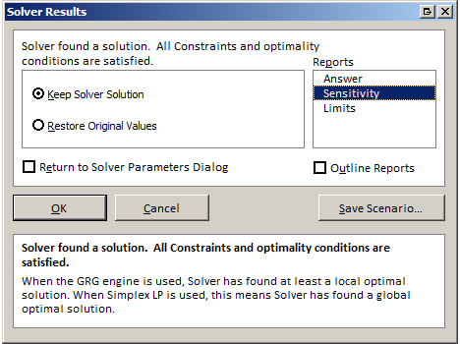
Try it out:
Open the Excel file: “0503…”
Click on “Data Tab”, then “Solver”
Click on “Solve”
When Solver Results appear, highlight “Sensitivity” report and click “OK”

Slide 18
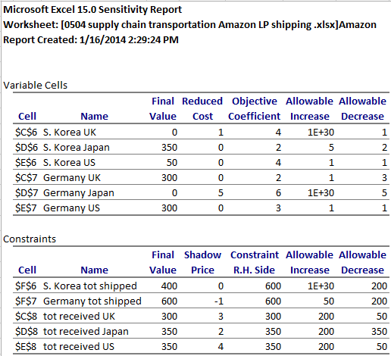

Shadow Prices tell us the answer
If you increase a constraint by 1 unit, by how much will the objective (total shipping costs) change?
Increase supply?
One unit in Germany?
Lowers cost by $1
Increase demand?
One unit in UK?
Raises cost by $3

Slide 19
FINANCE: Capital Budget
Star Oil Company is considering five different investment opportunities. The cash outflows and net present values ($M) are shown below. Star Oil has $40M available for investment now (time 0); it estimates that one year from now (time 1) $20M will be available for investment. Star Oil may purchase any fraction of each investment (between 0 and 1).
If you want to follow along, this is in the file: 0504 LP…xls

Slide 20
Notes about Linear Programming
The optimal solution, if it exists, will quickly be found (or the LP will let you know that no solution is possible)
Even complicated linear programming problems can be solved relatively quickly
Research problem with 816 decision variables and 1.3 million parameters in the constraints solved in a few seconds
May have to be creative to keep from multiplying variables (which would be a non-linear relationship)
Don’t forget the non-negativity constraints!

